Slide 1
TechWise Team 4 Project 1
Project Update Week 5 August 10, 2022

Slide 2
Project Team Members
Dennis Bowen – Frontend/Backend
Viktoriia Denys - Backend
James Rodgers- Backend
Alan Snyder – Frontend/Backend
Jackson Trainer – Frontend/Backend

Slide 3
Project Status
Completed
Scorecard updates with dynamically scoring
In process
New start menu to select the number of players
New end game, discard and shuffle tile button
UI improvements and standardization
Confirmation window for closing game
Removable tile before Submitting words
End game logic
Return tiles to tray, discard tiles
Notes:
James

Slide 4
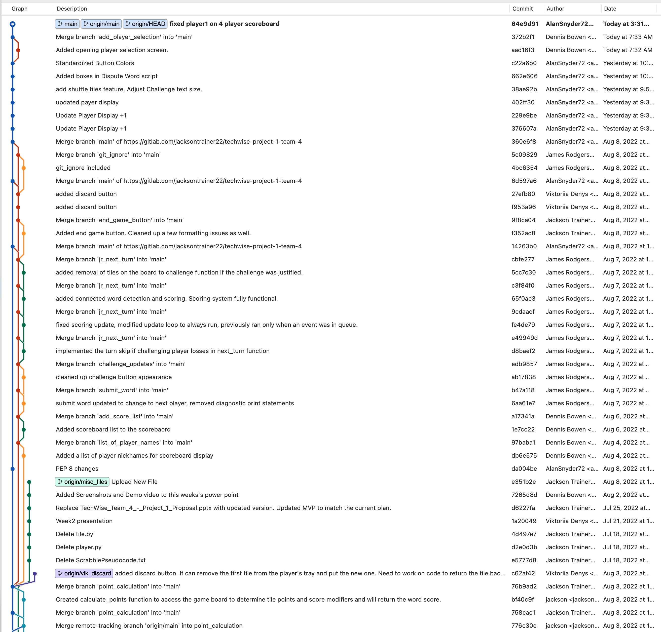
Git Commit 8/3 to 8/10
Notes:
James

Slide 5
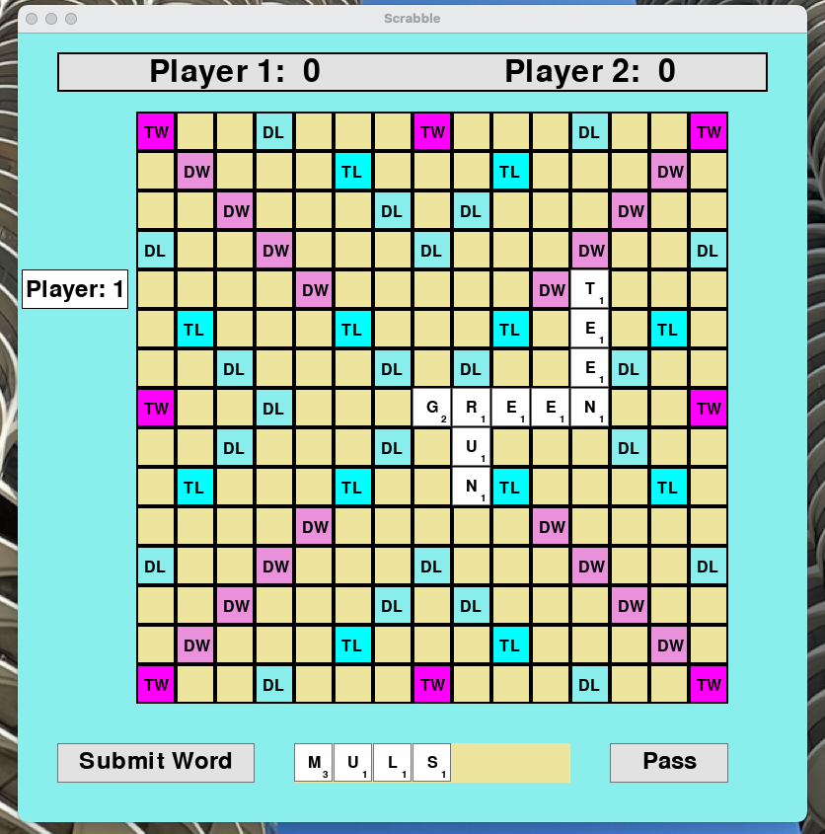
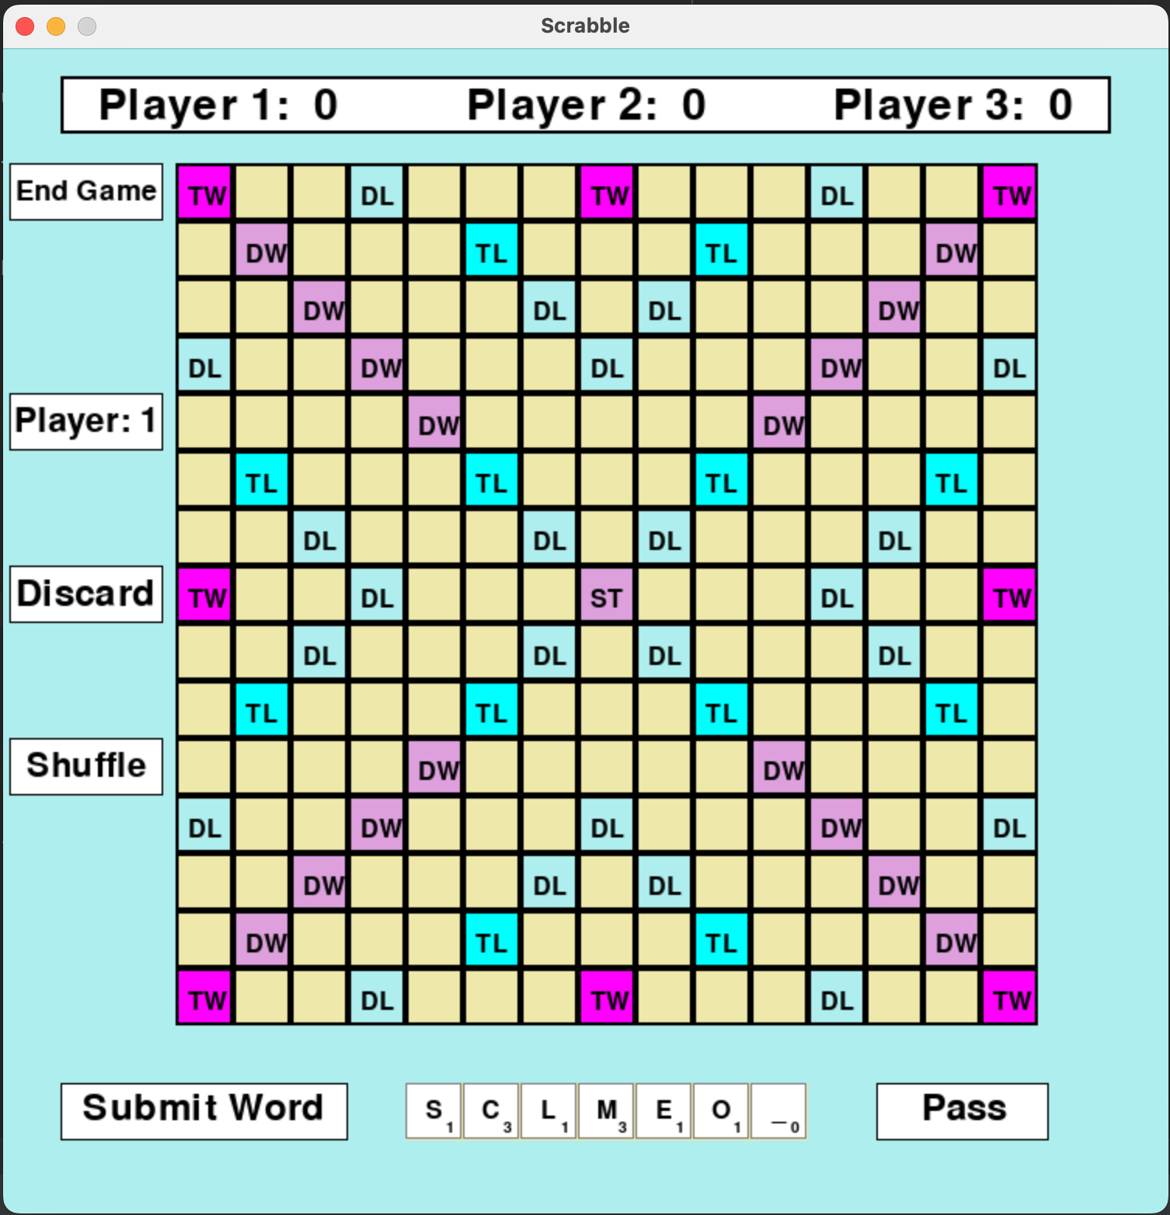
In Process Screenshots
Previous Version
Current Version
2 Player only
No End Game Option
Cannot Discard tiles
Cannot Shuffle Tiles
Tile Board does not refill
Multi-Player to 4 player options with scoring
End Game Option
Discard tiles
Shuffle Tiles on Tile Board
Tile Board refills at the beginning of each turn
Notes:
Jackson

Slide 6
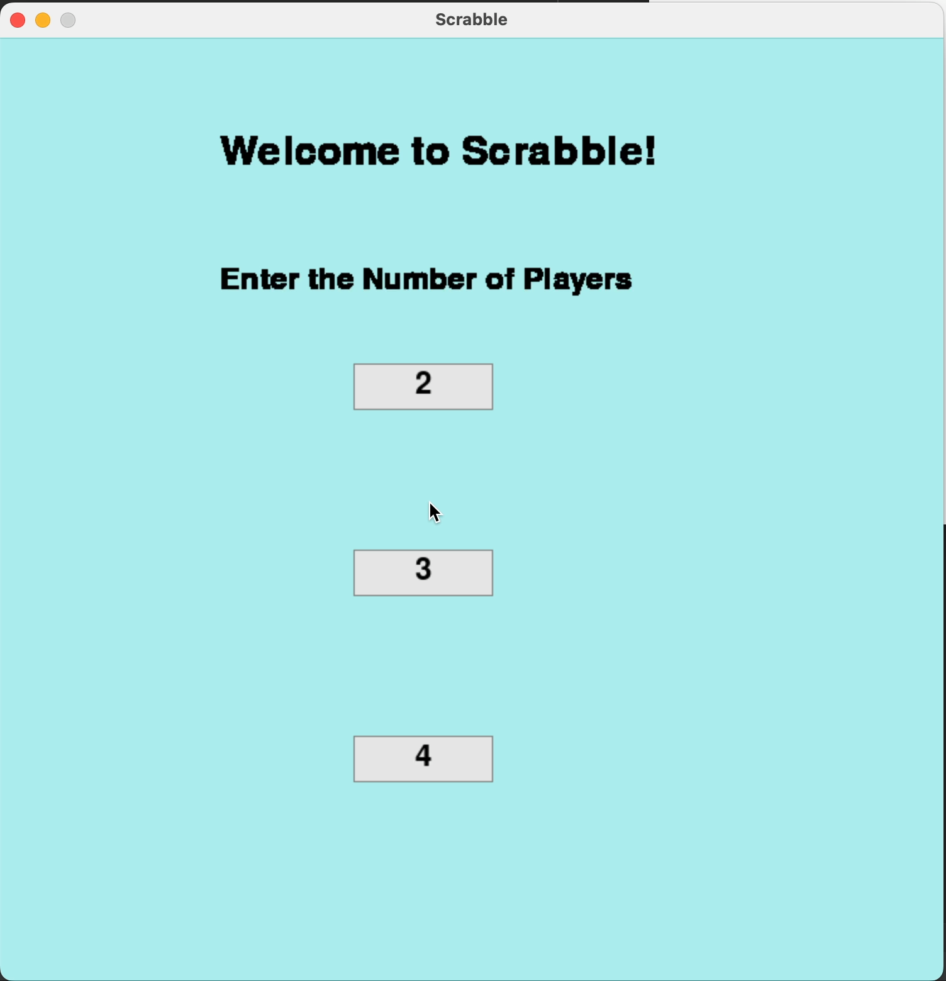
Demo New Multi-player Screen New Scoring System Discard a tile Button Shuffle tiles Button End Game Button
Notes:
Jackson

Slide 7
Challenges and Lessons Learned
Challenges
Dynamically creating player objects based on user input
Working with multiple classes to interact correctly
Lessons Learned
Creating title screens and buttons in PyGame
When to take a break when troubleshooting
Notes:
Denis – Challenges
Alan Lessons Learned

Slide 8
Project Timeline
Project Kickoff
Week 1- 7/6
Completed initial pseudocode
Week 2 – 7/13
Created Player, Tile, Tile Bag, Controller objects
Game board designed with basic features
Week 3 – 7/20
Display tiles on the game board
Multiple functions related to tile placement and interaction
Week 4 – 7/27
Basic scoring logic
Discard tiles
Improve on-screen buttons (submit, pass, discard)
Week 5 - 8/3
Finish discard tiles
Dynamic to the game board
Reorder tiles in the tray
Discard tiles,
Remove tiles from the board
Number of player setup,
End game button
Continue to improve GUI
Week 6 - 8/10
Application testing
Bug fixes
Build Freeze – 8/18
Presentation
Notes:
Viktoriia

Slide 9
Question?

